Slide 1
krypt.semper pi.
krypt. semper pi.
martin boßlet

Slide 2
krypt.semper pi.
whoami
ruby-core
ruby openssl
freelancer

Slide 3
krypt.semper pi.
crypto is hard

Slide 4
krypt.semper pi.
u can't touch this

Slide 5

krypt.semper pi.
touched crypto

Slide 6
krypt.semper pi.
only a select few
can really master

Slide 7
krypt.semper pi.
the arcane art that is cryptography

Slide 8
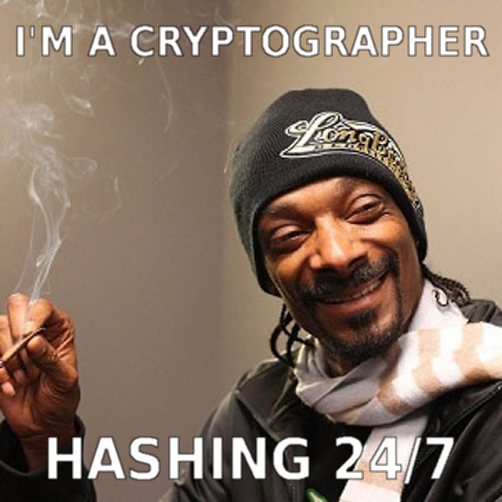
krypt.semper pi.
mastered crypto

Slide 9
krypt.semper pi.
so, if crypto is hard

Slide 10
krypt.semper pi.
do crypto apis have to be, too?

Slide 11
krypt.semper pi.
two opposing forces

Slide 12
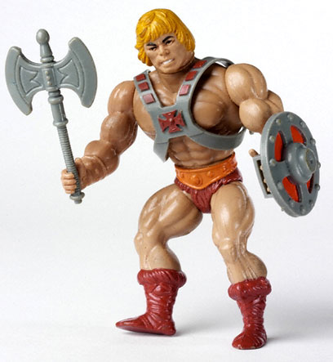
krypt.semper pi.
„when i refactored our login,
i mostly cared about security. what do i care about algorithms? i need my time to work out!“

Slide 13
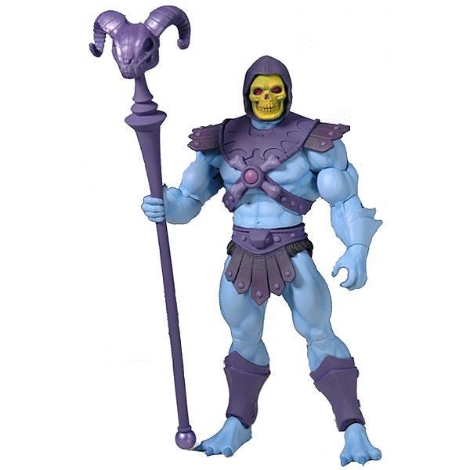
krypt.semper pi.
„i did a lot of ssl pentesting lately.
i need full control of all parameters. and i sure do need my legacy algorithms, dude.“

Slide 14
krypt.semper pi.
everyday development:

Slide 15
krypt.semper pi.
security sucks
security sucks.

Slide 16
krypt.semper pi.
„oh no, not security again!“
security sucks.

Slide 17

krypt.semper pi.
security is the jar jar binks
of software development

Slide 18
krypt.semper pi.
krypt first of all is a framework
describe Cryptography do
it 'shouldn't be touched by mere mortals' do
expect {
write_crypto(:joe_programmer)
}.to raise_error(ArgumentError)
end
it 'should only be written by experts in the field' do
expect { hire_expert }.to be_the_default
end
end

Slide 19
krypt.semper pi.
krypt first of all is a framework
describe Cryptography do
context 'reality' do
let(:expert) { :joe_programmer }
it 'shouldn't be touched by mere mortals' do
hope { write_crypto(expert) }.not_to raise_error(ToldYaSo)
end
it 'should only be written by experts in the field' do
expect { hire_expert }.to raise_error(BudgetError)
end
end
end

Slide 20
krypt.semper pi.
so here's your catch-22:

Slide 21
krypt.semper pi.
every app needs a security guy

Slide 22
krypt.semper pi.
but not
every security guy needs your app

Slide 23
krypt.semper pi.
good design
==
making complex things easy
security sucks.

Slide 24
krypt.semper pi.
databases are hard -> active record
security sucks.

Slide 25
krypt.semper pi.
threads are hard -> stm, actors
celluloid
security sucks.

Slide 26
krypt.semper pi.
memory is hard -> gc
security sucks.

Slide 27
krypt.semper pi.
why do crypto libraries still
force us to deal with the bare metal?
security sucks.

Slide 28
krypt.semper pi.
don't bother me with details
security sucks.

Slide 29
krypt.semper pi.
but experts™ need full control
security sucks.

Slide 30
krypt.semper pi.
conflict
security sucks.

Slide 31
krypt.semper pi.
abstraction vs. oversimplification
security sucks.

Slide 32
krypt.semper pi.
there is no golden middle
security sucks.

Slide 33
krypt.semper pi.
if full control is your thing:

Slide 34
krypt.semper pi.
openssl
java security api
&
friends

Slide 35
krypt.semper pi.
if all you care about is security by default:

Slide 36
krypt.semper pi.
keyczar (no friends)

Slide 37
krypt.semper pi.
(maybe nacl / libsodium)

Slide 38
krypt.semper pi.
why not just use keyczar and be done with it?

Slide 39
krypt.semper pi.
well, there's the experts™

Slide 40

krypt.semper pi.
and legacy apps

Slide 41
krypt.semper pi.
we need both

Slide 42
krypt.semper pi.
full control if needed

Slide 43
krypt.semper pi.
security by default otherwise

Slide 44

krypt.semper pi.
„sadly we can't have both. or can we?“

Slide 45
krypt.semper pi.
revolutionary idea

Slide 46
krypt.semper pi.
combine both aspects in one library

Slide 47
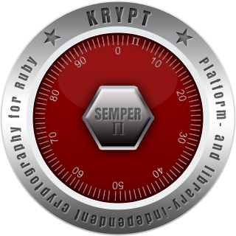
krypt.semper pi.
krypt. semper pi.

Slide 48
krypt.semper pi.
ok, cool, but...

Slide 49

krypt.semper pi.

Slide 50

krypt.semper pi.
who we are
@nahi, @vipulnsward, @abstractj, @qmx, @_emboss_

Slide 51
krypt.semper pi.
krypt first of all is a framework
krypt first of all is a framework

Slide 52
krypt.semper pi.
using existing libraries
to implement
core cryptography primitives
krypt first of all is a framework

Slide 53
krypt.semper pi.
peaceful coexistence
(at least at first)
krypt first of all is a framework

Slide 54

krypt.semper pi.
krypt first of all is a framework
expert™
„i see – this is the low-level api that gives me the full control that i so badly need“

Slide 55
krypt.semper pi.
digest
cipher
signature
krypt first of all is a framework

Slide 56
krypt.semper pi.
krypt first of all is a framework
„let's say i start an app from scratch and all i really care about is the thing being secure – what do i do then?“

Slide 57
krypt.semper pi.
krypt also offers higher-level protocols
using the lower-level ones as a basis
krypt first of all is a framework

Slide 58
krypt.semper pi.
what's the big deal?
krypt first of all is a framework

Slide 59
krypt.semper pi.
crypto code today
krypt first of all is a framework

Slide 60
krypt.semper pi.
#1 encrypting data
krypt first of all is a framework

Slide 61
krypt.semper pi.
what it should look like
krypt first of all is a framework

Slide 62
krypt.semper pi.
krypt first of all is a framework
require 'openssl'
data = 'le secret'
cipher = OpenSSL::Cipher.new('aes-128-cbc')
cipher.encrypt
key = cipher.random_key
iv = cipher.random_iv
enc = cipher.update(data) + cipher.final
decipher = OpenSSL::Cipher::AES.new('aes-128-cbc')
decipher.decrypt
decipher.key = key
decipher.iv = iv
plain = decipher.update(enc) + decipher.final

Slide 63
krypt.semper pi.
what it actually looks like
krypt first of all is a framework

Slide 64
krypt.semper pi.
krypt first of all is a framework
require 'openssl'
data = 'le secret'
key = 'lepasswordlepassword'
cipher = OpenSSL::Cipher.new('AES-128-ECB')
cipher.encrypt
cipher.key = key
enc = cipher.update(data) + cipher.final
decipher = OpenSSL::Cipher::AES.new('AES-128-ECB')
decipher.decrypt
decipher.key = key
plain = decipher.update(enc) + cipher.final

Slide 65
krypt.semper pi.
krypt first of all is a framework
require 'openssl'
data = 'le secret'
key = 'lepasswordlepassword' # fail
cipher = OpenSSL::Cipher.new('AES-128-ECB')
cipher.encrypt
cipher.key = key
enc = cipher.update(data) + cipher.final
decipher = OpenSSL::Cipher::AES.new('AES-128-ECB')
decipher.decrypt
decipher.key = key
plain = decipher.update(enc) + cipher.final

Slide 66
krypt.semper pi.
krypt first of all is a framework
require 'openssl'
data = 'le secret'
key = 'lepasswordlepassword'
cipher = OpenSSL::Cipher.new('AES-128-ECB') # fail
cipher.encrypt
cipher.key = key
enc = cipher.update(data) + cipher.final
decipher = OpenSSL::Cipher::AES.new('AES-128-ECB') # fail
decipher.decrypt
decipher.key = key
plain = decipher.update(enc) + cipher.final

Slide 67
krypt.semper pi.
krypt first of all is a framework
require 'openssl'
data = 'le secret'
key = 'lepasswordlepassword'
cipher = OpenSSL::Cipher.new('AES-128-ECB')
cipher.encrypt
cipher.key = key
# no iv -> fail
enc = cipher.update(data) + cipher.final
decipher = OpenSSL::Cipher::AES.new('AES-128-ECB')
decipher.decrypt
decipher.key = key
# no iv -> fail
plain = decipher.update(enc) + cipher.final

Slide 68
krypt.semper pi.
krypt first of all is a framework
require 'openssl'
data = 'le secret'
key = 'lepasswordlepassword'
cipher = OpenSSL::Cipher.new('AES-128-ECB')
cipher.encrypt # design fail
cipher.key = key
enc = cipher.update(data) + cipher.final
decipher = OpenSSL::Cipher::AES.new('AES-128-ECB')
decipher.decrypt # design fail
decipher.key = key
plain = decipher.update(enc) + cipher.final

Slide 69
krypt.semper pi.
krypt first of all is a framework
require 'openssl'
data = 'le secret'
key = 'lepasswordlepassword'
cipher = OpenSSL::Cipher.new('AES-128-ECB')
cipher.encrypt
cipher.key = key
enc = cipher.update(data) + cipher.final # design fail
decipher = OpenSSL::Cipher::AES.new('AES-128-ECB')
decipher.decrypt
decipher.key = key
plain = decipher.update(enc) + cipher.final # design fail

Slide 70
krypt.semper pi.
#2 pbkdf2 password hash
krypt first of all is a framework

Slide 71
krypt.semper pi.
what it should look like
krypt first of all is a framework

Slide 72
krypt.semper pi.
krypt first of all is a framework
require 'openssl'
pass = 'le secret'
salt = OpenSSL::Random.random_bytes(16)
iter = 20000
len = OpenSSL::Digest::SHA1.new.digest_len # 20
hash = OpenSSL::PKCS5.pbkdf2_hmac_sha1(pass, salt, iter, len)

Slide 73
krypt.semper pi.
what it actually looks like
krypt first of all is a framework

Slide 74
krypt.semper pi.
krypt first of all is a framework
require 'openssl'
pass = 'le secret'
salt = pass
iter = 10
len = password.size
hash = OpenSSL::PKCS5.pbkdf2_hmac_sha1(pass, salt, iter, len)

Slide 75
krypt.semper pi.
krypt first of all is a framework
require 'openssl'
pass = 'le secret'
salt = pass # fail
iter = 10
len = password.size
hash = OpenSSL::PKCS5.pbkdf2_hmac_sha1(pass, salt, iter, len)

Slide 76
krypt.semper pi.
krypt first of all is a framework
require 'openssl'
pass = 'le secret'
salt = pass
iter = 10 # fail
len = password.size
hash = OpenSSL::PKCS5.pbkdf2_hmac_sha1(pass, salt, iter, len)

Slide 77
krypt.semper pi.
krypt first of all is a framework
require 'openssl'
pass = 'le secret'
salt = pass
iter = 10
len = password.size # fail
hash = OpenSSL::PKCS5.pbkdf2_hmac_sha1(pass, salt, iter, len)

Slide 78
krypt.semper pi.
krypt first of all is a framework
require 'openssl'
pass = 'le secret'
salt = pass
iter = 10
len = password.size
# design fail
hash = OpenSSL::PKCS5.pbkdf2_hmac_sha1(pass, salt, iter, len)

Slide 79
krypt.semper pi.
krypt first of all is a framework
require 'openssl'
pass = 'le secret'
salt = pass
iter = 10
len = password.size
o_O
hash = OpenSSL::PKCS5.pbkdf2_hmac_sha1(pass, salt, iter, len)

Slide 80
krypt.semper pi.
what it actually actually looks like
krypt first of all is a framework

Slide 81
krypt.semper pi.
krypt first of all is a framework
require 'openssl'
pass = 'le secret'
salt = pass
digest = OpenSSL::MD5.new
hash = digest.digest(salt + pass)

Slide 82

krypt.semper pi.

Slide 83
krypt.semper pi.
#3 certificate validation
krypt first of all is a framework

Slide 84
krypt.semper pi.
what it should look like
krypt first of all is a framework

Slide 85
krypt.semper pi.
krypt first of all is a framework
require 'openssl'
# who the fuck knows?!

Slide 86
krypt.semper pi.
almost impossible to do it correctly™
krypt first of all is a framework

Slide 87
krypt.semper pi.
online revocation checks
krypt first of all is a framework

Slide 88
krypt.semper pi.
openssl refuses to have dependencies
krypt first of all is a framework

Slide 89
krypt.semper pi.
relic of bygone times
before
dependency management tools
krypt first of all is a framework

Slide 90
krypt.semper pi.
we're left with half-assed validation
krypt first of all is a framework

Slide 91
krypt.semper pi.
krypto code tomorrow
krypt first of all is a framework

Slide 92
krypt.semper pi.
what it should actually look like
krypt first of all is a framework

Slide 93
krypt.semper pi.
#1 encrypting data
krypt first of all is a framework

Slide 94
krypt.semper pi.
krypt first of all is a framework
require 'krypt'
data = 'le secret'
encrypter = Krypt::Encrypter.new
key = encrypter.generate_key
enc = encrypter.encrypt(data)
decrypter = Krypt::Decrypter.new
decrypter.key = key
plain = decrypter.decrypt(data)

Slide 95
krypt.semper pi.
#2 password hash
krypt first of all is a framework

Slide 96
krypt.semper pi.
krypt first of all is a framework
require 'krypt'
pass = 'le secret'
hash = Krypt::PasswordHash.hash(pass)
begin
Krypt::PasswordHash.verify(hash)
rescue Krypt::PasswordHash::Error
# react
end
#swell

Slide 97
krypt.semper pi.
#3 certificate validation
krypt first of all is a framework

Slide 98
krypt.semper pi.
krypt first of all is a framework
require 'krypt'
certificate = Krypt::X509::Certificate.new(bytes)
begin
certificate.verify
rescue Krypt::X509::VerificationError
# react
end
#swell

Slide 99
krypt.semper pi.
don't bother me with details
security sucks.

Slide 100
krypt.semper pi.
security by default
security sucks.

Slide 101
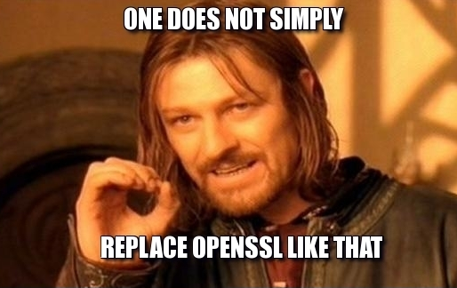
krypt.semper pi.
security sucks.

Slide 102
krypt.semper pi.
use
protocols

Slide 103
krypt.semper pi.
moar advantages:
security sucks.

Slide 104
krypt.semper pi.
moar tests
security sucks.

Slide 105
krypt.semper pi.
rspec
FuzzBert
security sucks.

Slide 106
krypt.semper pi.
moar docs (non-expert™)
security sucks.

Slide 107
krypt.semper pi.
moar ruby
security sucks.

Slide 108
krypt.semper pi.
easier to understand & maintain
security sucks.

Slide 109
krypt.semper pi.
minimal portion of native code
krypt first of all is a framework

Slide 110
krypt.semper pi.
using whatever library is available
krypt first of all is a framework
in the background

Slide 111
krypt.semper pi.
the rest is plain ruby
krypt first of all is a framework

Slide 112
krypt.semper pi.
„but why should anyone care about your stupid crypto library?!“

Slide 113
krypt.semper pi.
write once, run anywhere™
krypt first of all is a framework
2

Slide 114
krypt.semper pi.
run on all rubies
security sucks.

Slide 115
krypt.semper pi.
https
krypt first of all is a framework

Slide 116
krypt.semper pi.
if https doesn't work,
ruby doesn't work
krypt first of all is a framework

Slide 117
krypt.semper pi.
(https://rubygems.org, anyone?)
krypt first of all is a framework

Slide 118
krypt.semper pi.
openssl isn't available everywhere
krypt first of all is a framework

Slide 119
krypt.semper pi.
c (or java) extensions are not the answer
krypt first of all is a framework

Slide 120
krypt.semper pi.
only ruby runs everywhere
krypt first of all is a framework

Slide 121
krypt.semper pi.
this is part of java's success
krypt first of all is a framework

Slide 122
krypt.semper pi.
provider (native code)
krypt (ruby code)
krypt first of all is a framework
ffi / native code

Slide 123
krypt.semper pi.
use openssl on jruby
krypt first of all is a framework

Slide 124
krypt.semper pi.
same code runs on all platforms
krypt first of all is a framework

Slide 125
krypt.semper pi.
using different parts to get there
krypt first of all is a framework

Slide 126
krypt.semper pi.
write once, run anywhere™
krypt first of all is a framework
2

Slide 127
krypt.semper pi.
future: all-ruby provider
krypt first of all is a framework

Slide 128
krypt.semper pi.
„if it runs ruby, it runs krypt“
krypt first of all is a framework

Slide 129
krypt.semper pi.
think:
webrick
vs.
thin, unicorn, puma, torquebox
krypt first of all is a framework

Slide 130
krypt.semper pi.
eat your own dog
...err food
krypt first of all is a framework

Slide 131
krypt.semper pi.
easier said than done
krypt first of all is a framework

Slide 132
krypt.semper pi.
„zomg this needs to be fast,
let's write a c extension !!!“
krypt first of all is a framework

Slide 133
krypt.semper pi.
been there, done that
krypt first of all is a framework

Slide 134
krypt.semper pi.
asn.1
c & java implementations
krypt first of all is a framework

Slide 135
krypt.semper pi.
fast
\o/
krypt first of all is a framework

Slide 136
krypt.semper pi.
code duplication
/o\
krypt first of all is a framework

Slide 137
krypt.semper pi.
let's give ruby a try
krypt first of all is a framework

Slide 138
krypt.semper pi.
https://github.com/krypt/krypt-asn1-rb
krypt first of all is a framework

Slide 139
krypt.semper pi.
much less code
krypt first of all is a framework

Slide 140
krypt.semper pi.
that i still understand one week later
krypt first of all is a framework

Slide 141
krypt.semper pi.
Krypt::Asn1.decode String(n=100000) 1.418942
Krypt::Asn1.decode StringIO(n=100000) 1.353945
OpenSSL::ASN1.decode String(n=100000) 4.948085
OpenSSL::X509::Certificate String(n=100000) 3.466104
krypt first of all is a framework
MRI

Slide 142
krypt.semper pi.
Krypt::Asn1.decode String(n=100000) 0.903000
Krypt::Asn1.decode StringIO(n=100000) 0.896000
OpenSSL::ASN1.decode String(n=100000) 7.920000
OpenSSL::X509::Certificate String(n=100000) 8.247000
krypt first of all is a framework
JRUBY

Slide 143
krypt.semper pi.
Krypt::Asn1.decode String(n=100000) 2.807615
Krypt::Asn1.decode StringIO(n=100000) 2.535868
OpenSSL::ASN1.decode String(n=100000) 16.184046
OpenSSL::X509::Certificate String(n=100000) 10.918114
krypt first of all is a framework
RBX

Slide 144
krypt.semper pi.
this is worthy repeating:
krypt first of all is a framework

Slide 145
krypt.semper pi.
we are talking
ruby
vs.
c & java
here
krypt first of all is a framework

Slide 146
krypt.semper pi.
streaming parser
with
lazy evaluation
krypt first of all is a framework

Slide 147
krypt.semper pi.
it's not so much the
programming language,
but the algorithm
that counts
krypt first of all is a framework

Slide 148
krypt.semper pi.
use ruby™
krypt first of all is a framework

Slide 149
krypt.semper pi.
still a long road ahead of us
krypt first of all is a framework

Slide 150
krypt.semper pi.
plan: krypt as default crypto library
plan: krypt as default crypto library
krypt first of all is a framework

Slide 151
krypt.semper pi.
moar plan:
use openssl polyfill for the interim period
krypt first of all is a framework

Slide 152
krypt.semper pi.
https://github.com/krypt/krypt-ossl
krypt first of all is a framework

Slide 153
krypt.semper pi.
thank you
https://github.com/krypt
http://martinbosslet.de
martin.bosslet@gmail.com
@_emboss_
krypt first of all is a framework

